Slide 1

Financial Accounting
Dr.Smita Jape
Associate Professor
DR.V.N.BRIMS

Slide 2
Inventory accounting Chapter 7

Slide 3
Inventory
Inventory refers to purchased goods with the intention of reselling, or produced goods (including labor, material & manufacturing overhead costs).
FIFO and LIFO - The methods are not actually linked to the tracking of physical inventory, just inventory Total balance cost
This does mean a company using the FIFO method could be offloading more recently acquired inventory first, or vice-versa with LIFO.
However, in order for the cost of goods sold (COGS) calculation to work, both methods have to assume inventory is being sold in their intended orders.

Slide 4
Inventory
Inventory accounting determines the specific value of assets at certain stages in their development and production.
This accounting method ensures an accurate representation of the value of all assets, company-wide.
Careful examination by a company of these values could lead to increased profit margins at each stage of the product.

Slide 5
How Inventory Accounting Works
GAAP requires inventory to be properly accounted for according to a very particular set of standards, to limit the potential of overstating profit by understating inventory value.
Profit is revenue minus costs.
Revenue is generated by selling inventory. If the inventory value (or cost) is understated, then the profit associated with the sale of the inventory may be overstated. That can potentially inflate the company's valuation.

Slide 6
How Inventory Accounting Works
The other item the GAAP rules guard against is the potential for a company to overstate its value by overstating the value of inventory. Since inventory is an asset, it affects the overall value of the company. A company which is manufacturing or selling an outdated item might see a decrease in the value of its inventory. Unless this is accurately captured in the company financials, the value of the company's assets and thus the company itself might be inflated.

Slide 7
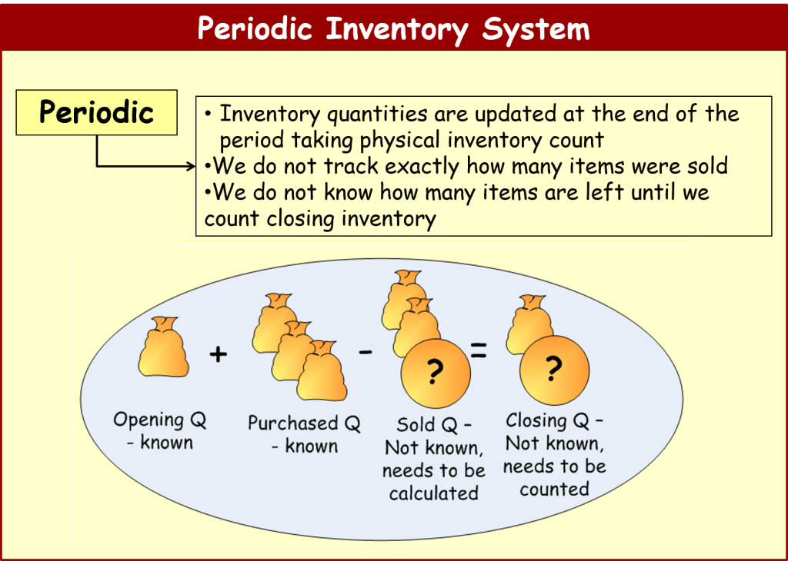
Advantages of Inventory Accounting
The main advantage of inventory accounting is to have an accurate representation of the company's financial health. However, there are some additional advantages to keeping track of the value of items through their respective production stages. Namely, inventory accounting allows businesses to assess where they may be able to increase profit margins on a product at a particular place in that product's cycle.
This can be seen most prominently in products that require exceptional time or expense in secondary stages of production. Items such as pharmaceuticals, machinery, and technology are three products that require large amounts of expense after their initial designing. By evaluating the value of the product at a certain stage⁠—such as clinical trials or transportation of the product⁠—a company can adjust the variables at that stage to keep the product value the same while increasing their profit margins by decreasing expenses.

Slide 8
How Inventory Accounting Works
Inventory items at any of the three production stages can change in value.
Changes in value can occur for a number of reasons including depreciation, deterioration, obsolescence, change in customer taste, increased demand, decreased market supply, and so on.
An accurate inventory accounting system will keep track of these changes to inventory goods at all three production stages and adjust company asset values and the costs associated with the inventory accordingly.

Slide 9
How Inventory Accounting Works
A company's inventory typically involves goods in three stages of production:
raw goods,
in-progress goods, and
finished goods that are ready for sale.
Inventory accounting will assign values to the items in each of these three processes and record them as company assets.

Slide 10
LIFO/FIFO
FIFO and LIFO are methods used in the cost of goods sold calculation.
FIFO (“First-In, First-Out”) assumes that the oldest products in a company’s inventory have been sold first and goes by those production costs.
The LIFO (“Last-In, First-Out”) method assumes that the most recent products in a company’s inventory have been sold first and uses those costs instead.

Slide 11
Which Method Is Better FIFO or LIFO?
FIFO is considered to be the more transparent and trusted method of calculating cost of goods sold, over LIFO. Here’s why.
By its very nature, the “First-In, First-Out” method is easier to understand and implement. Most businesses offload oldest products first anyway – since older inventory might become obsolete and lose value. As such, FIFO is just following that natural flow of inventory, meaning less chance of mistakes when it comes to bookkeeping.

Slide 12
LIFO
allows a business to use the most recent inventory costs first.
These costs are typically higher than what it cost previously to produce or acquire older inventory. As such, profits are lower. Although this may mean less tax for a company to pay under LIFO,
also means stated profits with FIFO are much more accurate because older inventory reflects the actual costs of that inventory.
If profits are naturally high under FIFO, then the company becomes that much more attractive to investors.

Slide 13
FIFO and LIFO Examples
We are going to use one company as an example to demonstrate calculating the cost of goods sold with both FIFO and LIFO methods.
Ted’s Televisions is a business in New York City. Ted has been in operation now for a year. This is what his inventory costs looks like:
Month Amount Price Paid
January 100 Units Rs800.00 February 100 Units Rs800.00 March 100 Units Rs825.00 April 100 Units Rs825.00 May 100 Units Rs825.00 June 100 Units Rs850.00 July 100 Units Rs850.00 August 150 Units Rs875.00 September 150 Units Rs875.00 October 150 Units Rs900.00
November 150 Units Rs900.00 December 150 Units Rs900.00
1450 units acquired. Units = Televisions.

Slide 14
FIFO METHOD
As you can see, the unit price of televisions steadily increased. Assuming Ted kept his sales prices the same (which he did, in order to stay competitive), this means there was less profit for Ted’s Televisions by the end of the year.
For the year, the number of televisions sold was 1100.
Let’s calculate cost of goods sold using the:
Going by the FIFO method, Ted needs to use the older costs of acquiring his inventory and work ahead from there.
So Ted’s COGS calculation is as follows:
200 units x Rs800 = Rs160,000 300 units x Rs825 = Rs247,500 200 units x Rs850 = Rs170,000 300 units x Rs875 = Rs262,500 100 units x Rs900 = Rs90,000
Ted’s cost of goods sold is Rs930,000.

Slide 15
LIFO method
Going by the LIFO method, Ted needs to go by his most recent inventory costs first and work backwards from there.
450 units x 900 = Rs405,000 300 units x 875 = Rs262,500 200 units x 850 = Rs170,000 150 units x Rs825 = Rs123,750
Ted’s cost of goods sold is Rs 9,61,250.
You can see how for Ted, the LIFO method may be more attractive than FIFO. This is because the LIFO number reflects a higher inventory cost, meaning less profit and less taxes to pay at tax time.
The LIFO reserve in this example is Rs31,250. The LIFO reserve is the amount by which a company’s taxable income has been deferred, as compared to the FIFO method.
The remaining unsold 350 televisions will be accounted for in “inventory”.

Slide 16
Is LIFO Allowed Under GAAP?
Yes, LIFO is allowed under GAAP.
GAAP stands for “Generally Accepted Accounting Principles” and it sets the standard for accounting procedures in the United States. It was designed so that all businesses have the same set of rules to follow. GAPP sets standards for a wide array of topics, from assets and liabilities to foreign currency and financial statement presentation. Under GAAP, LIFO is legal.
Outside the United States, LIFO is not permitted as an accounting practice. This is why you’ll see some American companies use the LIFO method on their financial statements, and switch to FIFO for their international operations.
Most other countries are required to follow the rules set down by the IFRS (International Financial Reporting Standards) Foundation.

Slide 17
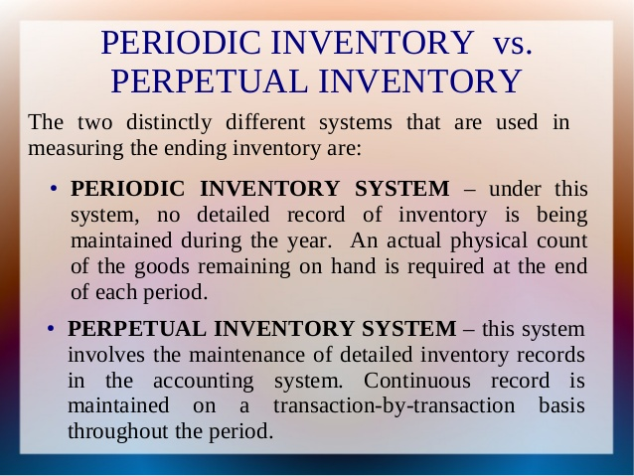
Periodic/Perpetual

Slide 18
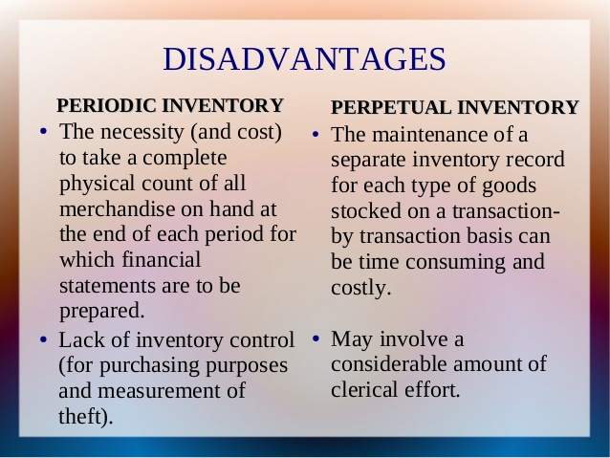
Periodic/Perpetual

Slide 19
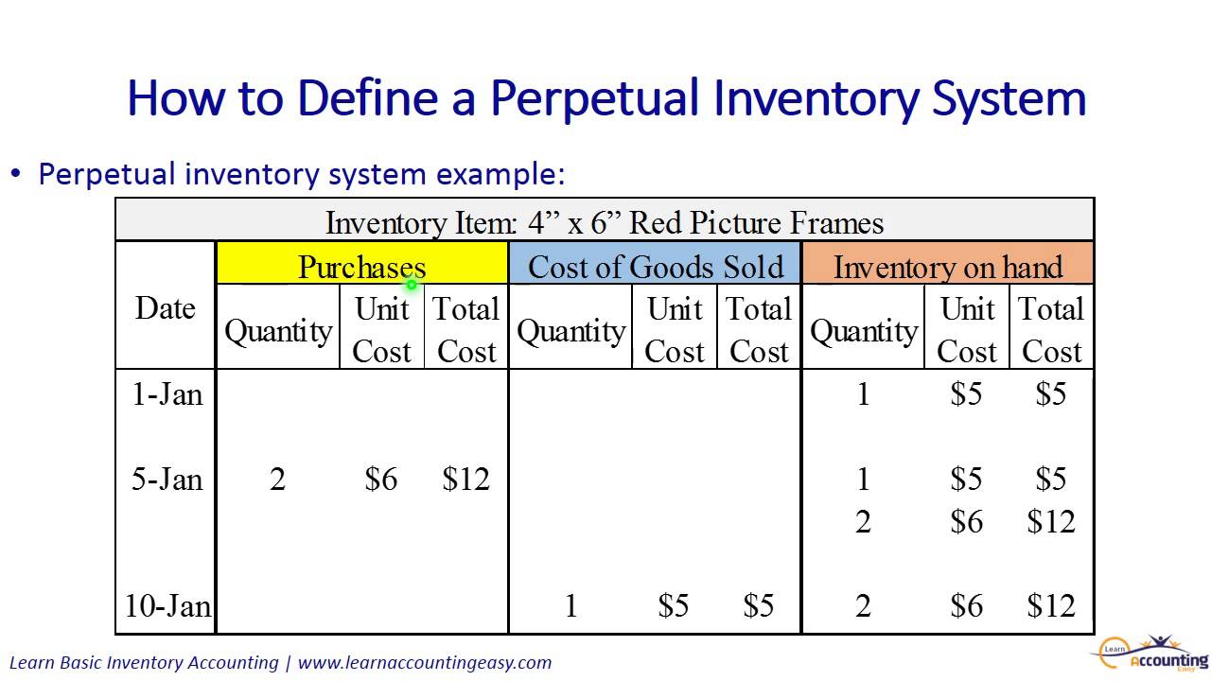
Perpetual Inventory Accounting

Slide 20
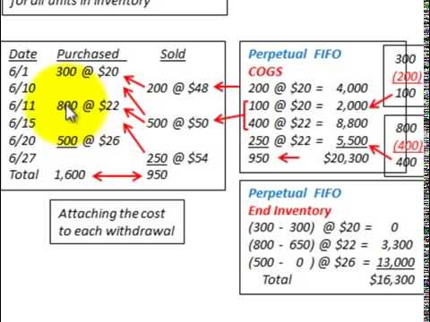
Perpetual Inventory Accounting

Slide 21
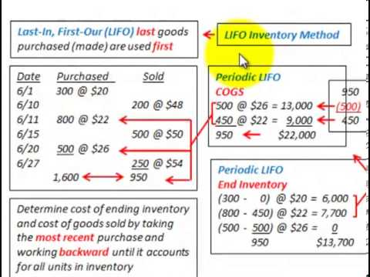
LIFO/FIFO

Slide 22
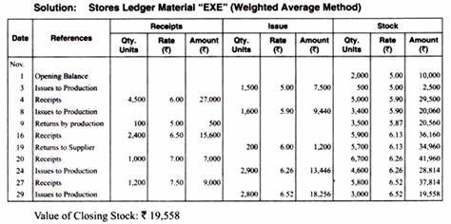
Weighted average method

Slide 23
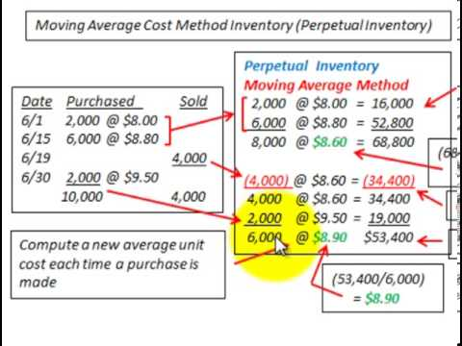
Moving average Cost Method

Slide 24
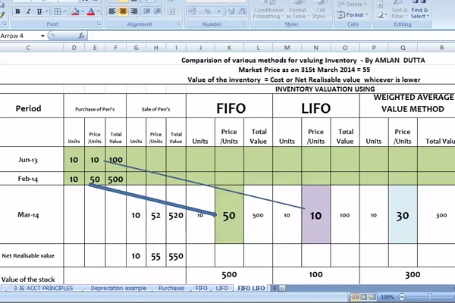
LIFO/FIFO/Weighted Average Value

Slide 25
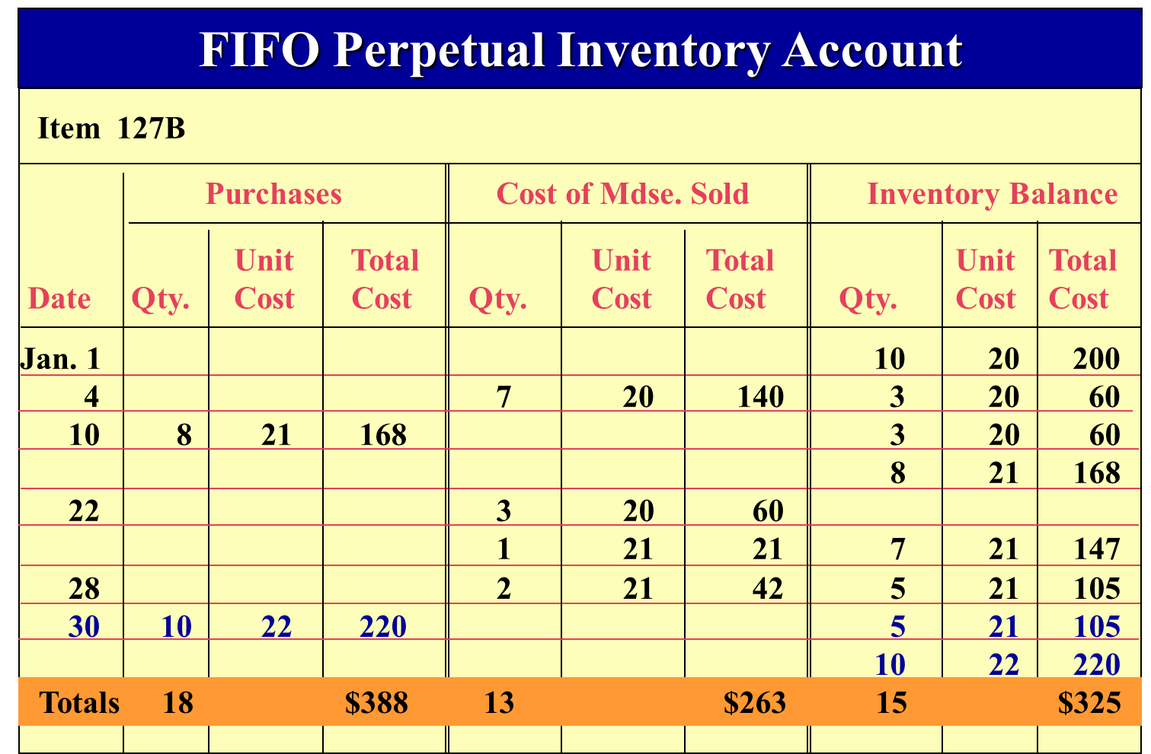
FIFO PERPETUAL

Slide 26
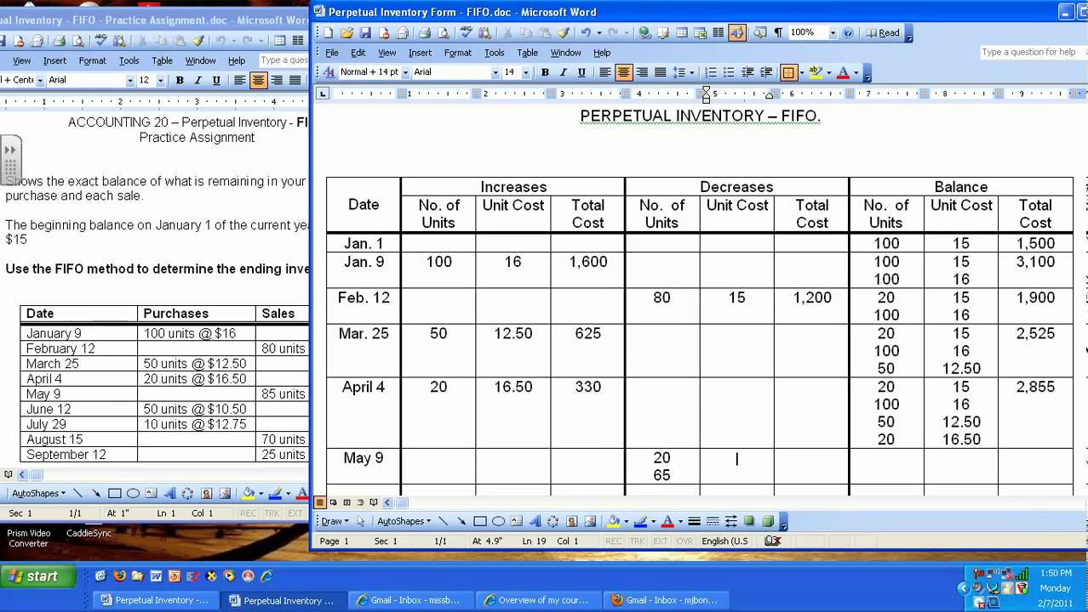
PERPETUAL INVENTORY FIFO

Slide 27
Problem # (1):
Don Barco has recently started a new business which deals in a single product. The first three months of his year of trading showed the following purchases and sales:

Slide 28
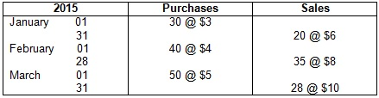
Required:
Calculate value of inventory as at 31 March 2015 under FIFO method of inventory valuation.

Slide 29
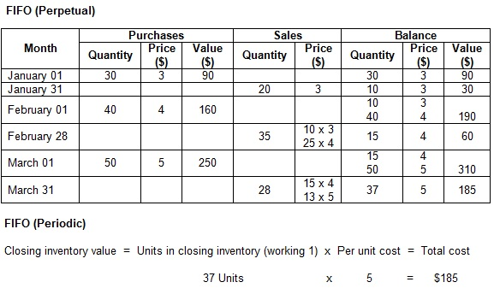
Calculation of Closing Inventory (FIFO Perpetual and FIFO Periodic)

Slide 30
LIFO Method
April 01: Inventories on hand: 50 units at the rate of $2 and 100 units at the rate of $1.50.
April 05: Purchased 100 units at a rate of $1.80.
April 06: 10 units of the inventories purchased on 5th April at the rate of $1.80 are returned to supplier.
April 10: 80 units were issued to factory.
April 15: 50 units were issued to factory.
April 20: 20 units were purchased at a rate of $1.50.
April 25: 70 units were issued to the factory.
April 30: 50 units purchased at $1.70.
April 30: Out of units issued to factory on 25th April, 10 units were returned to the store.
Using the last in first out (LIFO) method, show the value of inventory in hand on 30th April.

Slide 31
